Slide 1

Cow Face Detection for Precision Livestock Management using YOLOv8
Umair Ali¹, Wasif Muhammad²

Slide 2
Biography
Umair Ali is a PhD student in Electrical Engineering at the University of Gujrat, specializing in computer vision and livestock behavior recognition. His research focuses on AI-driven precision agriculture, utilizing deep learning for livestock monitoring and identification.
He holds MS in Electrical Engineering (2020) from the University of Gujrat (UOG) and a Bachelor’s in Electrical Engineering (2018) from the University of Management and Technology (UMT). His research contributions include a published paper on multi-sensor fusion for underwater robot self-localization, featured by Emerald Publishing Limited.
Currently, he is working on advanced deep learning models for cow face recognition, enhancing automated livestock management systems. With expertise in Python, machine learning, and data analysis, Umair continues to contribute to AI-driven agricultural advancements while pursuing cutting-edge research in computer vision.

Slide 3
Outline
Introduction
Problem Statement
Literature Review
Methodology
Results and Discussion
Conclusion

Slide 4
1. Introduction
Importance: Cows are vital for food security, economic stability and rural livelihood.
Cow management is essential to ensure optimal productivity, animal health and overall stability.
Facial recognition helps to recognize animals to keep tracking of their health as compared to conventional methods.
Idea of research:
Accurate recognition accuracy can be increased with facial features that can be extracted with first accurate detection of cow faces. A powerful Yolo model is used to efficiently detect cow faces in complex environment.

Slide 5
2. Problem Statement
Precision Livestock management is labour extensive and error prone so there Is need for camera based advance systems to track performance of cows for their productivity. Traditional vision-based methods like Convolution neural network CNNs are not sufficient because of occlusions and lighting variations to recognize cows in complex environment so there is a need to detect cow face first for accurate recognition in dynamic environments.

Slide 6
3. Literature Review
Traditional methods: Ear tagging and RFID are commonly used but have limitations in scalability and durability.
Camera-based systems:
Provide a sustainable and automated alternative for cow identification.
Facial recognition:
Eliminates the need for physical tags, making livestock management more efficient.
CNNs:
Extract complex facial features but require diverse datasets to avoid overfitting.
YOLOv8:
Enables fast and accurate cow face detection, improving identification in real-time. Transfer learning and fine tuning will enhance accuracy.

Slide 7
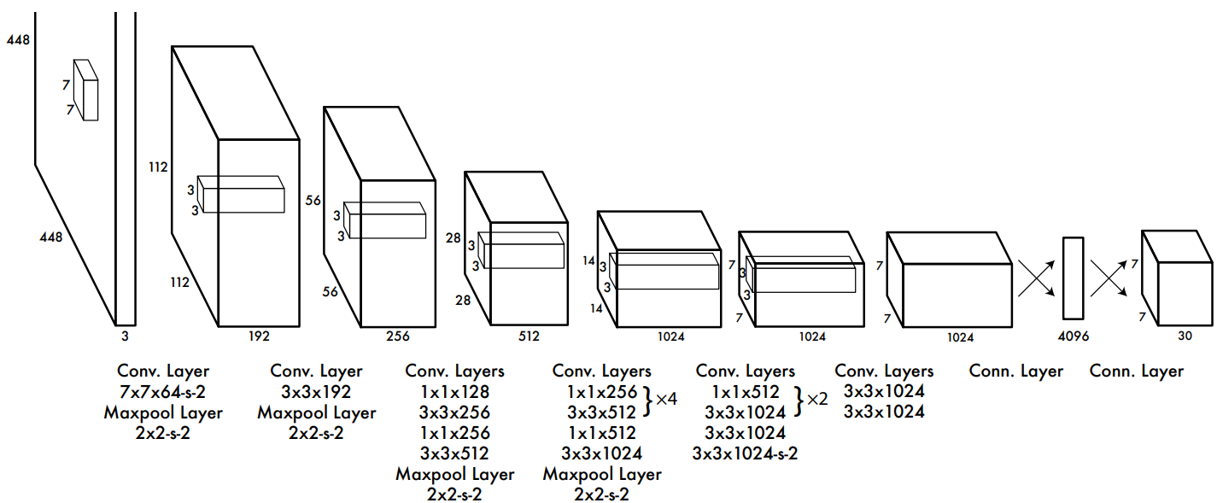
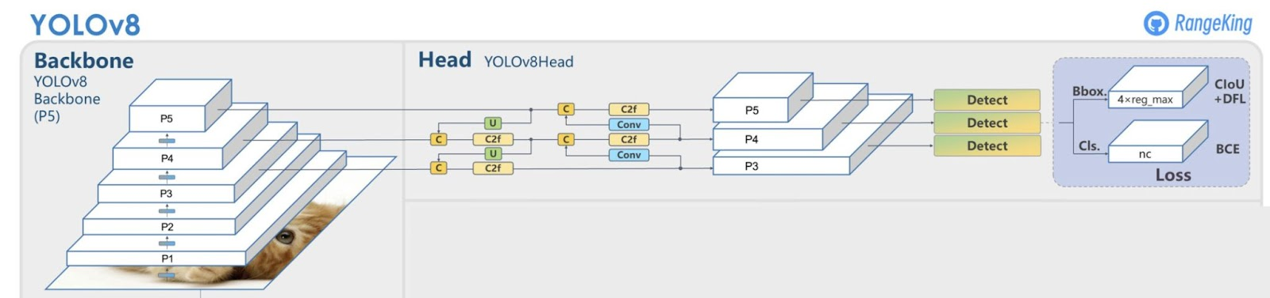
4. Methodology (structure of Yolo versions)
Yolo algorithm structure
Improvements in Yolov8

Slide 8
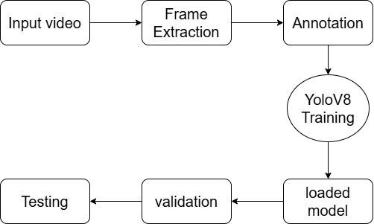
4. Methodology (implementation)
Training:
YOLOv8 fine-tuned with COCO weights on an augmented cow face dataset.
Dataset:
The dataset consists of 5,096 images, including 1,800 for training, 560 for validation, and 86 for testing, after augmentation of 2,488 original images from 37 cows and 1,410 additional annotated images from Roboflow.
Optimization:
Uses loss function combining bounding box regression, confidence, and classification.
Performance:
Achieves real-time, high-accuracy detection, outperforming SSD and Faster R-CNN.

Slide 9
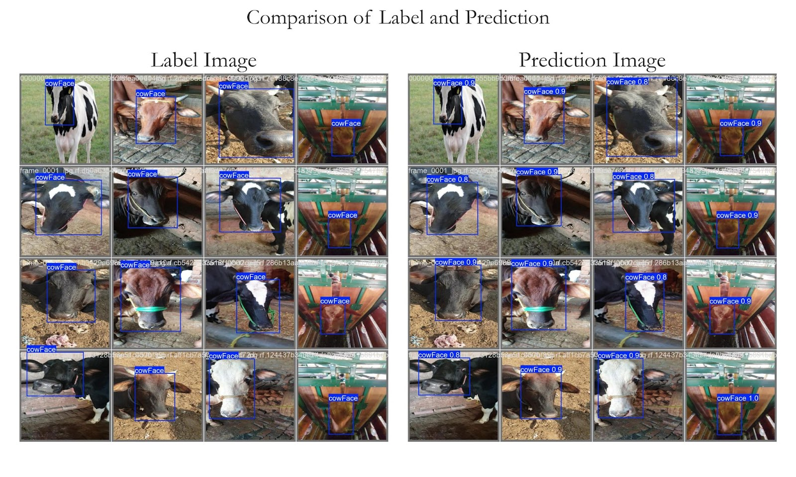
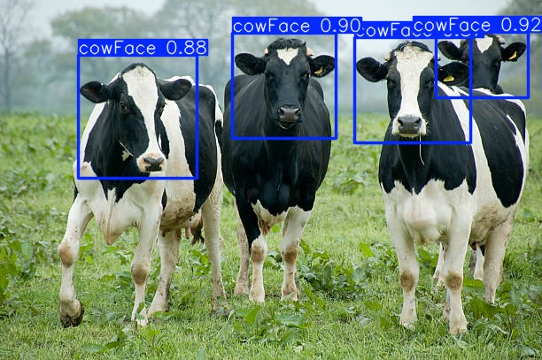
5. Results and Discussion
Yolo Comparison with SSD and Faster R-CNN (speed perspective)
Yolov8 based prediction after labeling
Web based image testing

Slide 10
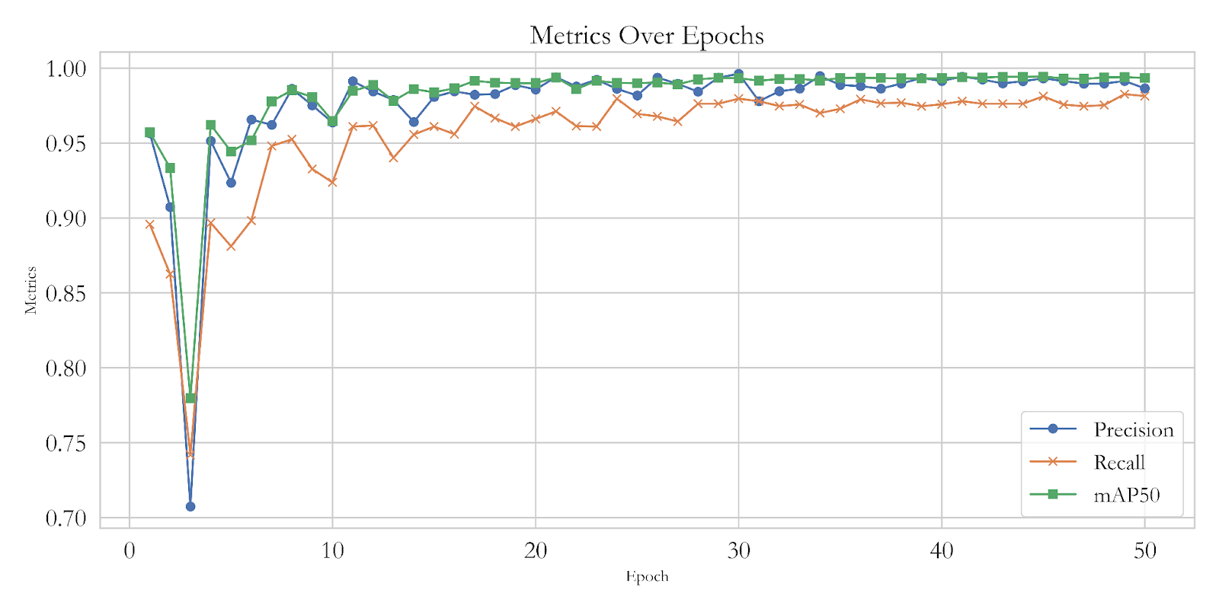
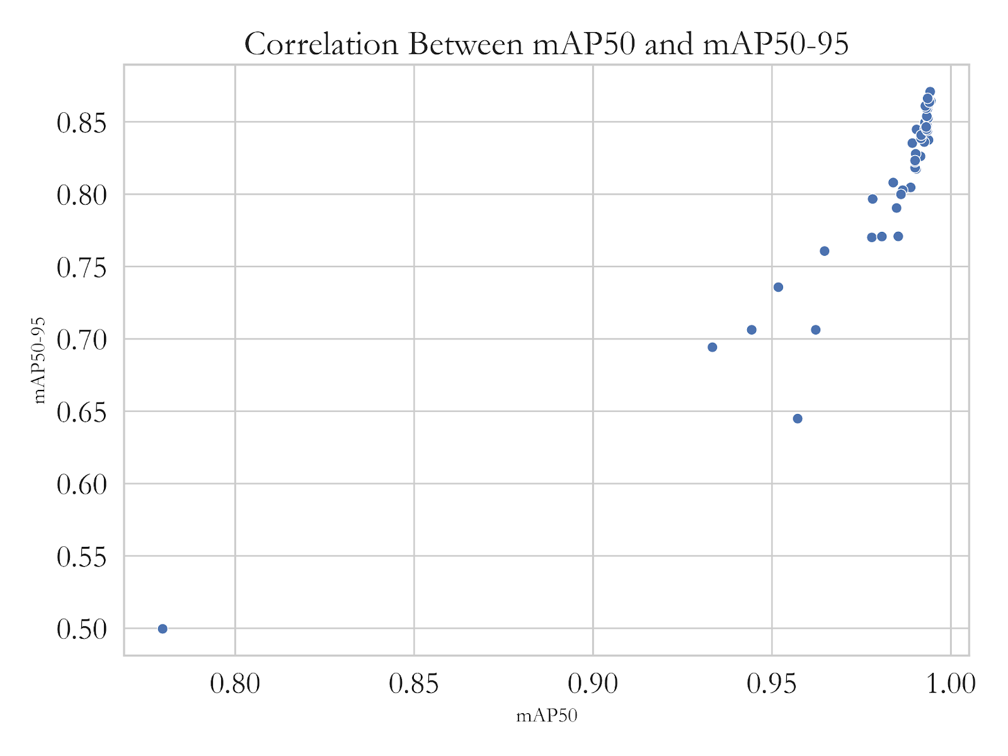
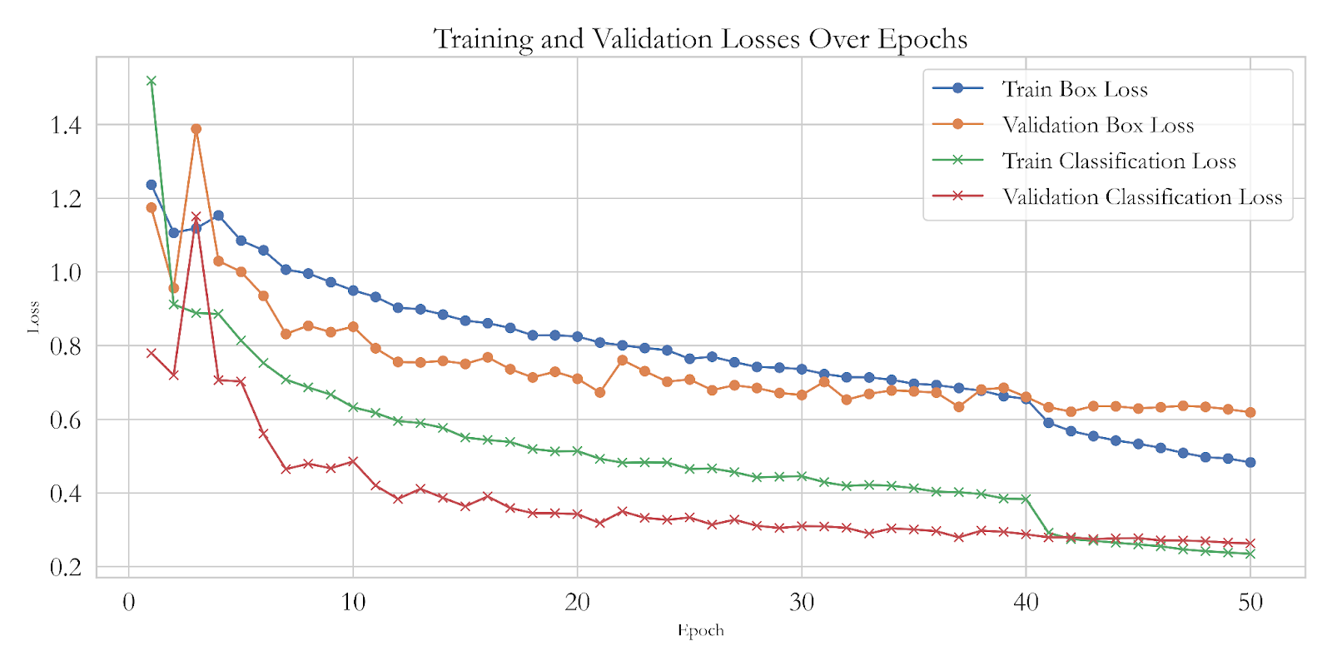
5. Results and Discussion
Correlation between mAP50 and mAP50-95
Losses in training
Correlation

Slide 11
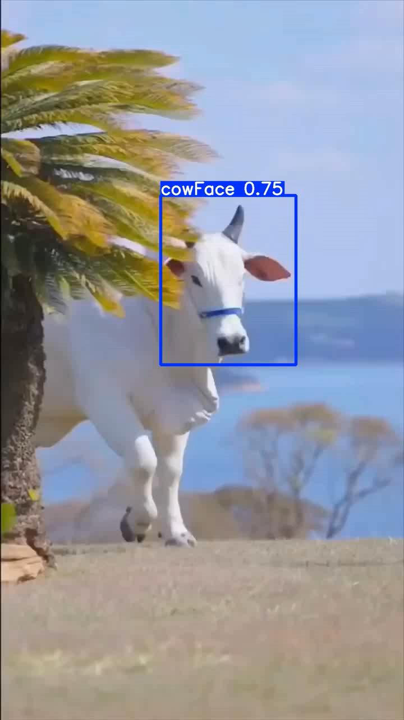
6. Conclusion
Transfer-learning based approach presented.
High precision and high recall
Strong correlation between mAP50 and mAP50-95.
Yolov8 based cow facial detection lays foundation for accurate cow recognition and monitoring.
Edge devices can use this trained model for cow detection

